Slide 1
Virtualization

Slide 2
Learning Objectives
Analyze details of virtualization concept
Understand different types of virtualization techniques
Explore interoperability standards
Concept of VLAN,VSAN and VM

Slide 3
Virtualization technology
A massively growing concept of computing and IT
A creation of new virtual version of any product or service
Example ??

Slide 4
Virtualization is separation of resources and requests
Example is virtual memory
The combination of virtual infrastructure offers a layers of abstraction between computing, networking hardware, storage and various applications that is running on it

Slide 5
Virtual Machine
A closely detached software device that could run its own operating systems and application as if it is running on physical computer.
It contains its own virtual RAM, hard disk, CPU and Network interface card.

Slide 6
Guest Operating System
Operating System running in a VM environment or on different physical system.

Slide 7
Hypervisor
A hypervisor or virtual machine monitor (VMM) is a software that creates and runs virtual machines.
A computer on which a hypervisor is running one or more virtual machines is defined as a Host machine.
E.g. Oracle Virtual Box

Slide 8
Hosted Virtualization
A virtualization method where virtualization and partitioning services run on top of an OS
E.g. VMware Workstation.

Slide 9
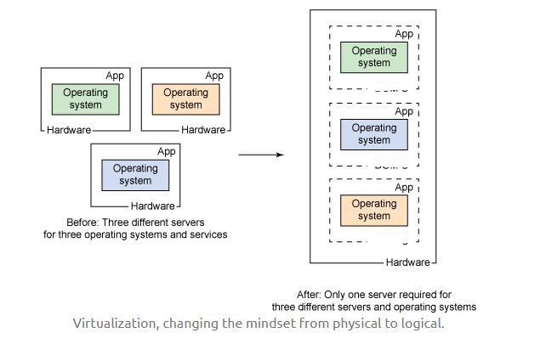

Slide 10
Overview of x86 Architecture

Slide 11
Before Virtualization
There is one OS image per machine
Software and hardware are tightly bound
Multiple applications that run on same machine usually create complexity
Resources are not used optimally
Infrastructure is neither flexible nor economically effective

Slide 12
After Virtualization
Provisioning of VMs can be done on any system
OS and application work as a single unit
OS and applications are independent of hardware

Slide 13
Types of Virtualization

Slide 14
CPU Virtualization
Also called as x86 virtualization

Slide 15
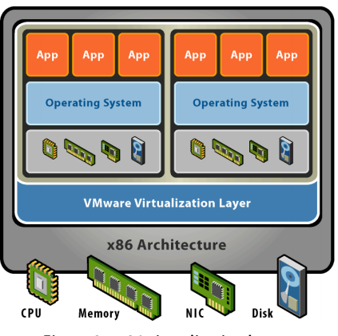

Slide 16
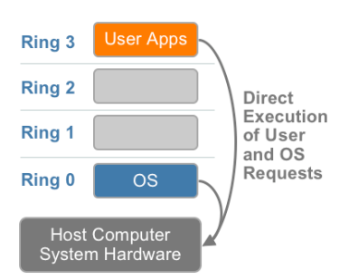
x86 Privilege Level Architecture

Slide 17
Challenges of x86 Hardware Virtualization
x86 operating systems are designed to run directly on the Bare-metal hardware, so they naturally assume that they fully own the computer hardware.
Some sensitive instructions can’t effectively be virtualized as they have different semantics when they are not executed in Ring 0.

Slide 18
The difficulty in trapping and translating these sensitive and privileged instruction requests at runtime was the challenge that originally made x86 architecture virtualization look impossible.
Three alternative techniques now exist for handling sensitive and privileged instructions to virtualizes the CPU in x86 architecture.

Slide 19
a) Full virtualization using Binary Translation
b) Paravirtualization or OS-Enabled virtualization
c) Hardware Assisted Virtualization

Slide 20
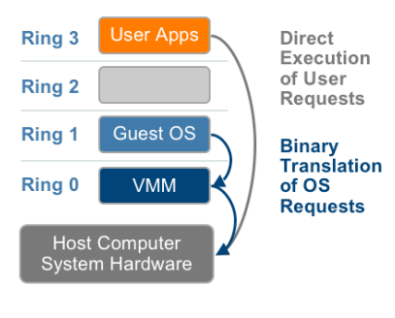
Full Virtualization using Binary Translation

Slide 21
Full Virtualization using Binary Translation
This approach translates kernel code to replace non virtualizable instructions with new sequences of instructions that have the intended effect on the virtual hardware. Meanwhile, user level code is directly executed on the processor for high performance virtualization.
Each virtual machine monitor provides each Virtual Machine with all the services of the physical system, including a virtual BIOS, virtual devices and virtualized memory management.

Slide 22
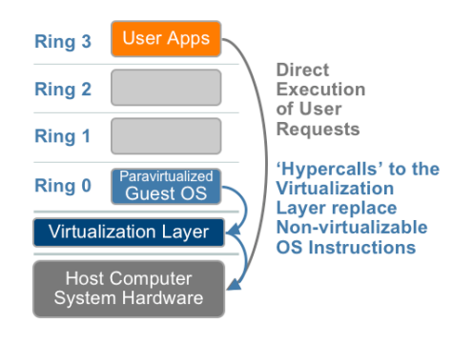
Para virtualization or OS-Assisted Virtualization

Slide 23
Paravirtualization refers to communication between the guest OS and the hypervisor to improve performance and efficiency.
Paravirtualization involve modifying the OS kernel to replace non virtualizable instructions with hypercalls that communicate directly with the virtualization layer hypervisor. The hypervisor also provides hypercall interfaces for other critical kernel operations such as memory management, interrupt handling and time keeping.

Slide 24
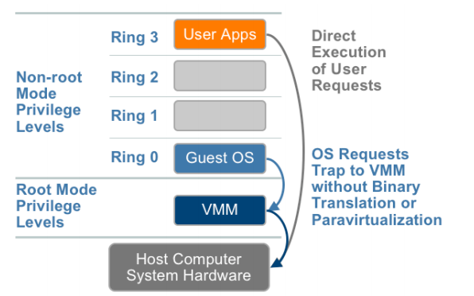
Hardware Assisted Virtualization

Slide 25
In this privileged and sensitive calls are set to automatically trap to the hypervisor, removing the need for either binary translation or paravirtualization. The guest state is stored in Virtual Machine Control Structures (VT-x) or Virtual Machine Control Blocks (AMD-V). Processors with Intel-VT and AMD-V

Slide 26
In this privileged and sensitive calls are set to automatically trap to the hypervisor, removing the need for either binary translation or paravirtualization.

Slide 27
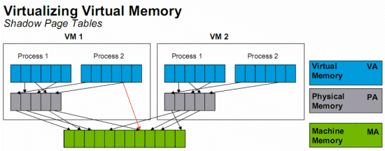
Memory virtualization:
This associates allotment of physical memory and dynamical allotment among all VMs.

Slide 28
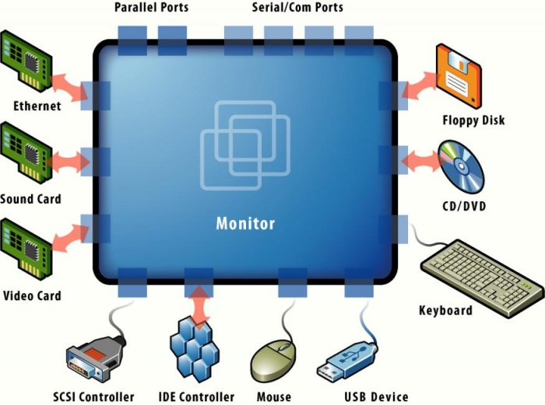
Device and I/O virtualization:
These include handling the routing of I/O requests between the shared physical hardware and virtual devices
Example: Virtual NICs

Slide 29
Client or Desktop virtualization:
It is like a separation of PC desktop environment from a physical machine through the client server model of computing
There are 2 types:
Remote (server-hosted) : OS is hosted on a server in the data center
Local (Client-hosted): OS runs locally on the user’s PC hardware

Slide 31
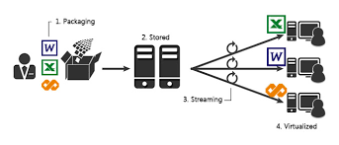
Application Virtualization
It is the execution of running software from a remote server rather than the user’s computer

Slide 32
